Slide 1

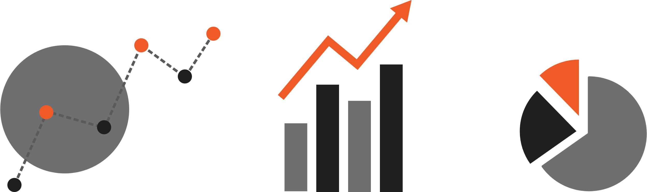


Media freedoms in BiH 2026.
Comparative report 2018 – 2026
Report
April, 2026

Slide 2
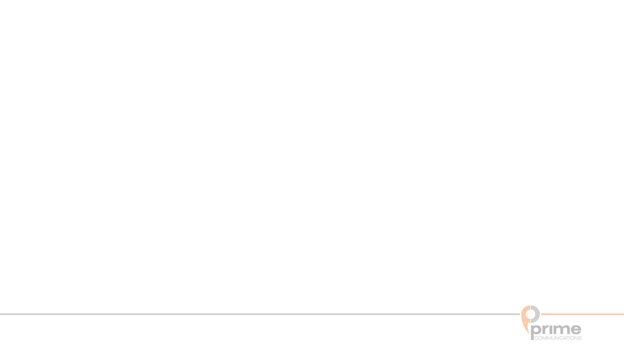
Naziv | Medijske slobode
Data collection method | Telephone interviews - CATI (computer assisted telephone interviews).
Sample | Sample size: n=502, FBiH: 332, RS: 160, Brčko 10 (standard sample error is ± 4,4). General population method of random selection of household land lines, representative sample older than 18 – last birthday technique
Questionnaire | Duration of questionnaire about 15 minutes
Implementation time | Survey start: 22.03.2026. Survey end: 07.04.2026.
Methodology and parameters

Slide 3
 |  | BiH |  | FBiH |  | RS
 |  | % | n | % | n | % | n
Sex | male | 50.2 | 252 | 50.8 | 169 | 48.4 | 77
 | female | 49.8 | 250 | 49.2 | 164 | 50.9 | 81
Age | 18 - 29 | 13.7 | 69 | 12.0 | 40 | 17.6 | 28
 | 30 - 39 | 18.1 | 91 | 14.1 | 47 | 27.0 | 43
 | 40 - 49 | 18.7 | 94 | 18.9 | 63 | 18.9 | 30
 | 50 - 59 | 25.3 | 127 | 28.5 | 95 | 16.4 | 26
 | 60+ | 23.9 | 120 | 26.4 | 88 | 19.5 | 31
 | Refused to answer | 0.2 | 1 | 0.0 | 0 | 0.0 | 0
Education | Primary and lower | 0.8 | 4 | 1.2 | 4 | 0.0 | 0
 | secondary | 56.4 | 283 | 64.6 | 215 | 39.0 | 62
 | Higher and above | 31.1 | 156 | 25.2 | 84 | 44.0 | 70
 | No answer | 11.6 | 58 | 8.7 | 29 | 17.0 | 27
Employment status | employed | 56.4 | 283 | 54.7 | 182 | 60.4 | 96
 | unemployed | 13.7 | 69 | 12.0 | 40 | 16.4 | 26
 | retired | 19.9 | 100 | 21.0 | 70 | 18.9 | 30
 | Stidents and pupils | 5.4 | 27 | 6.6 | 22 | 3.1 | 5
 | Other | 4.6 | 23 | 5.7 | 19 | 1.2 | 2
Nationality | Bosniak | 46.2 | 232 | 66.1 | 220 | 3.8 | 6
 | Croat | 12.2 | 61 | 18 | 60 | 0.6 | 1
 | Serb | 31.7 | 159 | 1.8 | 6 | 95.6 | 152
 | Other (Bosnians, Herzegovinians, Jews, Roma...) | 9.6 | 48 | 13.5 | 45 | 0.0 | 0
 |  | BiH |  | FBiH |  | RS
 |  | % | n | % | n | % | n
Type od settlement | city | 88.8 | 446 | 87.7 | 292 | 90.6 | 144
 | Outside of city | 10.6 | 53 | 12.0 | 40 | 8.2 | 13
Regions | Prijedor |  |  |  |  | 10.1 | 16
 | Banjaluka |  |  |  |  | 34.6 | 55
 | Doboj |  |  |  |  | 13.8 | 22
 | Bijeljina |  |  |  |  | 13.2 | 21
 | Zvornik |  |  |  |  | 12.6 | 20
 | Istočno Sarajevo |  |  |  |  | 4.4 | 7
 | Višegrad |  |  |  |  | 5.0 | 8
 | Herzegovina |  |  |  |  | 6.3 | 10
 | Una - Sana Canton |  |  | 12.3 | 41
 | Tuzla Canton |  |  | 23.1 | 77
 | Zernica - Doboj Canton |  |  | 17.1 | 57
 | Central Bosnia Canton |  |  | 10.2 | 34
 | Herzegovina – Neretva Canton |  |  | 9.6 | 32
 | West Herzegovina Canton |  |  | 5.1 | 17
 | Sarajevo Canton |  |  | 17.1 | 57
 | Canton 10 |  |  | 5.4 | 18
 | District Brčko | 100 | 10
Demographic structure

Slide 4
Main conclusions

Slide 5
In 2026, the citizens of Bosnia and Herzegovina trust the most the media (70.5%) and religious communities (52.2%), followed by government institutions (54.2%), the international community (32.9%), and the non-governmental sector (34.5%). Political parties (13.7%) and politicians (10.7%) gained the least trust from citizens. In comparison to 2025, we note a general increase in citizens' trust, mostly in the NGO sector and government institutions.
Certain differences were noticed at the entity level. In FBiH, the media is most trusted, followed by government institutions and religious institutions, while in RS the situation is reversed, religious communities are most trusted, then govenment institutions and media. Also, trust in institutions is currently generally higher among FBiH residents than among RS residents. Trust in political parties and politicians is higher in RS than in FBiH. In comparison to 2025, citizens’ trust in NGOs and the international community in RS is higher, but we must not forget that last year there was a strong and systematic campaign in RS against USAID, the NGO sector, and the OHR.
Residents of Bosnia and Herzegovina are only somewhat satisfied with the work of the media and journalists in the FBiH, but when we look at the responses by entities, the picture becomes very interesting. The largest number of respondents from the FBiH are mostly satisfied with the work in this entity, while among the respondents in the RS, the largest number of the respondents are completely dissatisfied. Compared to the year 2025, the percentage of people dissatisfied with the work of the media in the FBiH increased, but the percentage of those satisfied in the RS also increased.
Main conclusions 1/6

Slide 6
Compared to 2025, the percentage of BiH residents satisfied with the work of the media in the RS increased in 2026 from 9.9% to 16.7%. 31.7% are completely dissatisfied, and 27.7% are somewhat dissatisfied. The number of respondents in the RS who are satisfied with the work of the media in the RS is increasing, while dissatisfaction is decreasing, whereas in the FBiH the percentage of those dissatisfied with the work of the media in the RS is increasing, from 55.6% in 2025 to 82.6% in 2026.
Overall, satisfaction of all respondents with the work of the media in the FBiH remained the same as in 2025, while satisfaction with the work of the media in the RS increased. Residents of the Federation of BiH are less satisfied with the work of the media in that entity compared to 2025 by 10%, while this percentage is slightly higher among residents of the RS. Satisfaction with the work of the media in the RS increased among both residents of the FBiH and residents of the RS compared to 2025.
According to the opinion of two-thirds of respondents in BiH (68.9%), media freedom in the FBiH is partially present, while 9.4% think it is fully present, and 12.2% that it is not present at all.
If we look at the results by entity, we see that 23.9% of RS residents believe that media freedom is fully present in the FBiH, while 2.7% of FBiH residents think the same. Among the inhabitants of the FBiH, we find 82.6% who claim that media freedom is partially present, while 39.6% of the inhabitants of the RS think the same. Compared to 2025, the percentage of respondents from Bosnia and Herzegovina who believe that media freedom in the FBiH is not present increased by about 14%.
Media freedom in the RS is partially present for 31.1% of BiH residents, while 37.2% believe that it is not present at all. In the FBiH, the opinion that media freedom in the RS is not present at all is much more widespread (44.1%), while 24.5% of RS residents think the same. In the RS, slightly more than half of respondents believe that media freedom is partially present. Compared to 2025, we note a significant increase in RS residents who claim that media freedom is not present.
Main conclusions 2/6

Slide 7
The biggest obstacles to the free work of the media in BiH are their political dependence (66.9%), the general political climate in the country (54%), financial dependence (30.7%) and insufficient professionalism (21.9%). The differences compared to 2025 are minor. Compared to 2025, we only note an increase of 7% in the category of the general political climate.
In the FBiH, we note an increase only in perceptions of the general political climate (+8%). In the RS, trends are more complex: more respondents see the political climate as highly influential in 2026, while concern about an inadequate legal framework as an obstacle has risen by 20%.
Politicians and political parties have the greatest influence on the work of the media, and 74.1% of BiH residents think so, which is about 10% higher compared to 2025. Compared to last year, the percentage of respondents in BiH who believe that the OHR and the international community, as well as media owners, influence the work of the media has decreased.
In both the FBiH and the RS, we observe an increase in the influence of politicians and parties, while in the FBiH there is a decrease in the influence of media owners, and in the RS a decrease in the influence of the OHR and the international community by about 20%.
Two-thirds of BiH residents, or 68.3%, believe that the criminalization of defamation and the possibility of prosecuting journalists and editors has affected media freedom in the RS, while every fourth resident of the RS (25.8%) believes that it has not affected it at all.
Almost three-quarters of BiH citizens (72.1%) see politicians and political parties as the main violators of journalists’ rights and media freedoms, followed by media owners and editors (13.9%). Only 7.8% attribute this to the OHR and the international community. Differences between entities persist: in the FBiH, more respondents blame politicians, while 20.8% of RS residents point to the OHR and the international community as significant violators.
Main conclusions 3/6

Slide 8
5.2% of people in Bosnia and Herzegovina approve of attacks on journalists—4.2% in the Federation and 7.6% in Republika Srpska.
79,4% of respondents in BiH believe that the work of individual journalists is politically motivated - 75% of respondents from FBiH and 88.6% of respondents from RS. In comparison to 2025, among the inhabitants of the RS, we see a slight decline in those who believe that the work of some journalists is politically motivated.
When talking about the improvement of journalistic work and the quality of reporting, we see that respondents emphasize almost all the offered options as important, but there are differences between the entities. In the FBiH, they believe that there is room for improvement in all aspects of journalistic work, while in the RS, they believe that the emphasis should be placed on improving the working conditions of journalists and ensuring better implementation of the law on the protection of journalists' rights and improve their education system.
Television has lost its lead as a source of information in Bosnia and Herzegovina. 37.3% of residents rely on the internet, and with social media (30.5%), digital sources dominate, while television remains primary for 26.7%.
In FBIH, television is no longer the primary source of information; it has been caught up with by the internet, followed by social media. In Republika Srpska, the internet is the primary source of information, followed by social media and television.
When it comes to quality information among respondents in BiH, we see that the Internet dominates (48.3%), while television (35.9%) is in second place. In the FBiH, television and the Internet are equal as the best source of information, while in the RS the Internet has primacy.
Internet as a medium is important for 90.1% of respondents in BiH - 89.2% of respondents from FBIH and 91.2% of respondents from RS.
Main conclusions 4/6

Slide 9
Just over half of respondents in BiH (55.8%) believe male politicians and other public figures often violate the professional and human rights of female journalists, both in media interactions and on social media, more in the Federation (66.2%) than in RS (33.3%).
About half (49.7%) say politicians address female journalists differently than male media workers, again more in the Federation (70.1%) than in RS (36.7%).
Half of respondents in BiH (49.7%) agree that the way politicians address and speak to female journalists significantly differs from how they address and speak to men—journalists, cameramen, and other male media workers. Respondents from the Federation of Bosnia and Herzegovina agree more (70.1%) than those from RS (36.7%).
Just over half of respondents at the level of Bosnia and Herzegovina (58.9%) believe that politicians’ speech and their addressing of female journalists at press conferences and other public events is discriminatory, inappropriate, constitutes gender-based violence, and is contrary to constitutional principles and the laws of the state and entities. Respondents from FBiH agree more (69.3%) than those from RS (35.8%).
Nearly three-quarters of respondents in BiH (73%) believe that media outlets and organizations for the protection of women’s human rights should respond more effectively in cases of offensive speech and public violence against female journalists. Respondents from FBiH agree more (85%) than those from RS (46.8%).
Three-quarters of respondents in BiH (75.6%) believe that state institutions and bodies responsible for gender equality, as well as the judiciary, should work more and more effectively on punishing attacks on female journalists, regardless of whether the perpetrators are politicians, public officials, or ordinary citizens. Respondents from FBiH agree more (88.5%) than those from RS (47.8%).
Main conclusions 5/6

Slide 10
Three-quarters of respondents in BiH (76.6%) believe state institutions and the judiciary should more effectively punish attacks on female journalists, with higher agreement in the Federation (88.8%) than in RS (50.4%).
Just over half of respondents in BiH (55.3%) believe that in the past year, women politicians and women in public office have been portrayed negatively in public and through media content, using offensive language, hate speech, and gender-based stereotypes, thereby undermining their political reputation and dignity. Respondents from the FBiH agree more (63.1%) than those from RS (37.3%).
More than half of respondents in BiH (57.4%) believe that information about women—politicians and those in public office in media coverage, especially in comments on social networks, is not as objective, professional, or supportive as it is when reporting on men in political and public positions. This view is shared by 66.2% of respondents in the FBiH and 38.7% in RS.
The largest share of respondents in BiH (61.6%) believe that comments on media articles and social networks contain much more offensive language, as well as degrading and discriminatory remarks toward women in political and public life. Respondents from FBiH agree more (70.6%) than those from RS (41.5%).
The highest percentage of respondents in BiH (70.8%) believe that the media should more strongly respect women’s rights, gender equality, and the provisions of the Code of Journalistic Ethics when reporting on women in politics and public life. Respondents from FBiH agree more (81.7%) than those from RS (46.8%).
Main conclusions 6/6

Slide 11
Media freedoms in BiH

Slide 12
How much do you trust the work of the following institutions?
Displayed results “I trust them completely“ and “I somewhat trust them“ Basis: all respondents (n=502)
Trust in the work of institutions 2026.

Slide 13
How much do you trust the work of the following institutions?
Displayed results “I trust them completely“ and “I somewhat trust them“ Basis: all respondents (n=502)
Trust in the work of institutions(2018. - 2026.)

Slide 14
To what extent are you generally satisfied with the work of the media and journalists in the Federation BiH?
Basis: all respondents (n=502)
Satisfaction with the work of the media and journalists in the Federation BiH 2026

Slide 15
To what extent are you generally satisfied with the work of the media and journalists in the Federation BiH?
satisfied (“completely/somewhat satisfied “) dissatisfied “completely/somewhat dissatisfied “) Basis: all respondents (n=502)
Satisfaction with the work of the media and journalists in the Federation BiH(2018. – 2026.)

Slide 16
To what extent are you generally satisfied with the work of the media and journalists in Republika Srpska?
Basis: all respondents (n=502)
Satisfaction with the work of the media and journalists in Republika Srpska 2026.

Slide 17
To what extent are you generally satisfied with the work of the media and journalists in Republika Srpska?
satisfied (“completely/somewhat satisfied “) dissatisfied “completely/somewhat dissatisfied “) Basis: all respondents (n=502)
Satisfaction with the work of the media and journalists in Republika Srpska (2018. - 2026.)

Slide 18
To what extent are you generally satisfied with the work of the media and journalists in the Federation BiH?
To what extent are you generally satisfied with the work of the media and journalists in Republika Srpska?
satisfied (“completely/somewhat satisfied “ Basis: all respondents (n=502)
Satisfaction with the work of the media and journalists FBiH/RS (2018. - 2026.)

Slide 19
In Your opinion, what is the current freedom of the media in the Federation BiH?
Would You say that the freedom of the media in the Federation BiH is present?
Basis: all respondents (n=502)
Presence of the freedom of the media in the Federation BiH 2026.

Slide 20
In Your opinion, what is the current freedom of the media in the Federation BiH?
Would You say that the freedom of the media in the Federation BiH is present?
Displayed results “not present at all“ and “somewhat present“ Basis: all respondents (n=502)
Presence of the freedom of the media in the Federation (2018. - 2026.)

Slide 21
In Your opinion, what is the current freedom of the media in Republika Srpska?
Would You say that the freedom of the media in Republika Srpska is present?
Basis: all respondents (n=502)
Presence of the freedom of the media in Republika Srpska 2026.

Slide 22
In Your opinion, what is the current freedom of the media in Republika Srpska?
Would You say that the freedom of the media in Republika Srpska is present?
Displayed results “not present at all“ and “somewhat present“ Basis: all respondents (n=502)
Presence of the freedom of the media in Republika Srpska (2018. - 2026.)

Slide 23
In Your opinion, what are the two basic obstacles to free work of the media in BiH out of the following?
Basis: all respondents (n=502)
Basic obstacles to free work of the media in BiH (2018. – 2026.)

Slide 24
In Your opinion, what are the two basic obstacles to free work of the media in BiH out of the following?
(BiH)
Basis: all respondents (n=502)
Basic obstacles to free work of the media in BiH (2018. – 2026.)

Slide 25
In Your opinion, what are the two basic obstacles to free work of the media in BiH out of the following?
(FBiH)
Basis: all respondents (n=332)
)
Basic obstacles to free work of the media in BiH (2018. – 2026.)

Slide 26
In Your opinion, what are the two basic obstacles to free work of the media in BiH out of the following?
(RS)
Basis: all respondents (n=160)
Basic obstacles to free work of the media in BiH (2018. – 2026.)

Slide 27
In Your opinion, who of the following has the strongest influence on the work of the media in BiH?
Basis: all respondents (n=509)
… have the strongest influence on the work of the media in BiH 2026.

Slide 28
In Your opinion, who of the following has the strongest influence on the work of the media in BiH?
(BiH)
Basis: all respondents (n=502)
… have the strongest influence on the work of the media in BiH (2018. – 2026.)

Slide 29
In Your opinion, who of the following has the strongest influence on the work of the media in BiH?
(FBiH)
Basis: all respondents (n=332)
… have the strongest influence on the work of the media in BiH (2017. – 2025.)

Slide 30
In Your opinion, who of the following has the strongest influence on the work of the media in BiH?
(RS)
Basis: all respondents (n=160)
… have the strongest influence on the work of the media in BiH (2018. – 2026.)

Slide 31
In your opinion, how much has the criminalization of defamation and the possibility of criminal prosecution of journalists and editors affected media freedom in Republika Srpska?
Basis: all respondents (n=502)
Criminalization of defamation and media freedom in Republika Srpska 2026

Slide 32
Who are the main violators of journalists’ rights and media freedom in BiH?
Basis: all respondents (n=502)
Main violators of journalists’ rights and media freedoms in BiH 2026.

Slide 33
Which of the following statements would you agree with most?
Basis: all respondents (n=502)
Attacks on journalists 2026.

Slide 34
One of the most common criticisms directed at journalists by named politicians and influential individuals is that the work of some journalists is politically motivated. To what extent do you agree with this view?
Basis: all respondents (n=502)
Political motivation in the work of journalists 2026.

Slide 35
One of the most common criticism towards journalists by called-out politicians and influential people is that the work of some journalists is politically motivated. How much do you agree with that opinion?
Politicaly motivated („completely/somewhat agree“) not politicaly motivated(„completely/somewhat disagree“) Basis: all respondents (n=502)
Political motivation in the work of journalists (2018. - 2026.)

Slide 36
In your opinion, in which of the following ways should journalistic work and the quality of reporting be improved first?
Basis: all respondents (n=502)
Methods of improvement of the work of journalists and quality of reporting 2026.

Slide 37
Which of the following media is your first source of information?
Basis: all respondents (n=502)
First choice for obtaining information 2026.

Slide 38
Which media provides You with the highest quality information?
Basis: all respondents (n=502)
Quality of media for obtaining information 2026.

Slide 39
How do You rate the importance of the Internet as a media for the public and citizens?
Basis: all respondents (n=502)
Evaluation of importance of the Internet for the public and citizens 2026.

Slide 40
To what extent do You agree with the following statements on political influence in the media?
Politicians‘ speech and their addressing of female jourmalists at press conferences and other public events is discriminatory, disrespectful, constitutes gender-based violence, and is contrary to constitutional principles and the laws of the state and entities.
Male politicans and other public figures frequently violate the professional and human rights of female journalists during media interactions and via social networks.
The way politicians address amd speak to female journalists significantly differs from how they address male journalists, camermen, and other men working in the media.
Media outlets and organizations for the protection of women‘s human rights should respond more effectively in cases of offensive speech and public violence against female journalists.
State institutions and bodies responsible for gender equality, as well as judiciary, should do more and work more effecitely to punish attacks on female journalists, regardless of whether the perpetrators are politicians, public officials or ordinary citizens.
State institutions and the judiciary should do more and work more effectively to punish perpetrators of attacks on female journalists, regardless of whether they are politicians,public officials or orinary citizens.
Basis: all respondents (n=502
Evaluation of political influence in the media in 2026.

Slide 41
To what extent do You agree with the following statements ?
Over the past year, women politicians and women in public office have been negatively portrayed in public discourse and media content, using offensive language, hate speech, and gender-based stereotypes, therby undermining their political reputation and dignity.
Information about women, politicans and public officials, in media reports, especially in social media comments, is not as objective, professional or supportive as it is when reporting on men in political and public positions.
Comments on media articles and social networks contain much more offensive language and more degrading and discriminatory remarks toward women in political and public life.
  The media should respect women’s rights, gender equality and the Code of Journalistic Ethics to a greater extent when reporting on women in politics and public life.
Basis: all respondents (n=502)
Attitudes about insulting female politicians 2026.

Slide 42
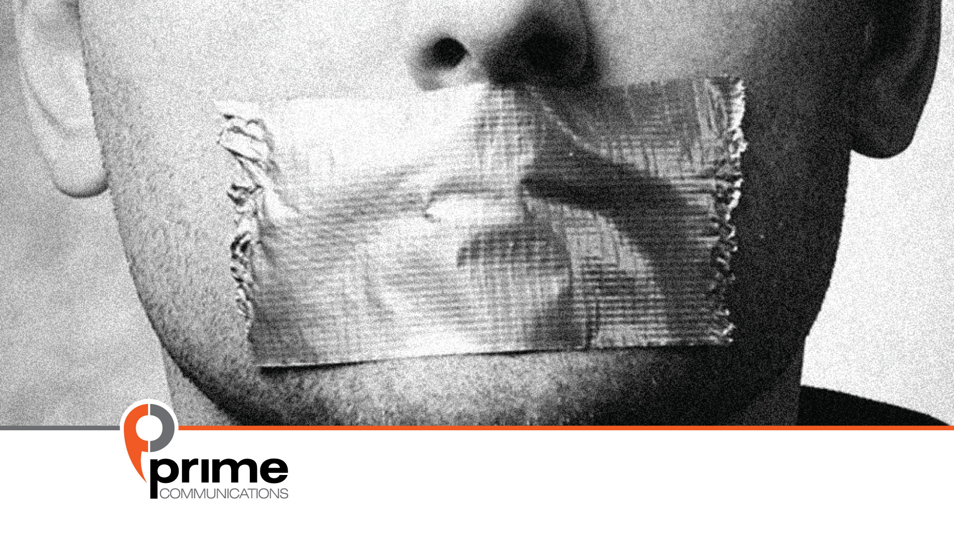
For more information:
srdjan.puhalo@prime.ba

